Slide 1
Brazilian E-commerce Analytics
Presented By
Insight Innovators Team
16 May, 2025
Notes:
Good evening, everyone! My name is Ganna Hassan And I’m here today to present our project idea under title Exploratory data analysis and machine learning for Brazilian E-commerce Database.

Slide 2
Special thanks
we would like to express our sincere gratitude to our supervisor,
Eng. Zyad Ayman.

Slide 3



Insight Innovators
Team

Slide 4
Team Members
Abdelrahman – Reporting & documents preparing
Ganna– Exploratory Data analysis & KPIs (SQL) & Modeling
Aya– Exploratory Data analysis & KPIs (SQL)
Fatima – KPIs (python) & Business Insights Guidance
Youssef Mohamed –Data Collecting, Data cleaning, preprocessing, models building (Python),forecasting.
Ersaa – Data visualization (Tableau) & KPIs (Python)

Slide 5
Problem Description

Slide 6



Problem Description
Inconsistent data
Missing & Incomplete Data
Outliers

Slide 7

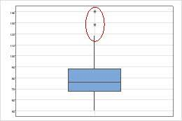



Proposed Solution
Handling Missing Values
Remove Duplicates
Identify Outliers
Develop Dashboards
Machine Learning
7

Slide 8
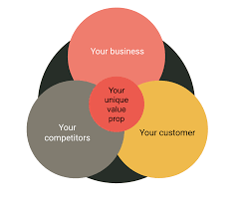
Unique Value Proposition
Our project bridges the gap between data and decision-making by offering a clear, interactive view of Brazil’s online retail landscape—helping businesses, spot opportunities and make data-driven choices faster.

Slide 9

Key Visualization
🗺️ Geospatial Map Visualizing sales volume by Brazilian state → Highlights regional demand patterns.
📦 Product Analytics Top categories by revenue → Identifies most profitable product lines.
📆 Sales by Time Heat or bar chart showing peak shopping hours → Optimizes marketing and operational timing.
💳 Payment Method Distribution Pie or bar chart of most used payment types → Helps tailor payment options to customer preferences.
👤 Customer Lifetime Value (CLV) Ranking customer segments by total value over time → Focuses on retention of high-value customers.

Slide 10





End Users and Features
Business Managers
Sellers
End Users
Vendors
Admins
Notes:
In this project, I focused on providing insights that help different departments inside an e-commerce company.
For example, business managers can use the overall KPIs to track performance.
The sales and marketing teams can analyze customer behavior and sales by region, so they know where to focus their campaigns.
The operations team will benefit from the shipping analysis to improve delivery times.
I also included analysis of payment methods and review scores to help improve customer experience.
These features make the dashboard practical and useful for decision-making across different departments.

Slide 11







End Users and Features
Interactive Dashboard
Payment Methods Distribution
Customer Purchase
Behaviour
Features
Customer Satisfaction Metrics
Review Score Trends
Shipping Performance

Slide 12
Intro

Slide 13
About the Data
Dataset Name: Brazilian E-commerce Public Dataset – Olist Store
Time Period: 2016 – 2018
Size: Over 100,000 orders from multiple marketplaces in Brazil
16/05/2025
13

Slide 14

About the Data
Key Data Dimensions:
Order status, price, and payment details
Shipping performance
Customer location
Product categories and attributes
Customer reviews
Geolocation (Zip code to Latitude/Longitude)
16/05/2025
14

Slide 15

About Olist – Business Context
Olist Overview:
Largest department store on Brazilian marketplaces
Connects small businesses to major sales channels
One contract → sell on multiple platforms
Products are shipped directly from sellers using Olist’s logistics partners.
16/05/2025
15

Slide 16

About Olist – Business Context
Customer Review Flow:
Customer places an order through Olist Store.
Seller is notified to fulfill the order.
After delivery (or estimated date), customer receives a satisfaction survey.
Customer provides a rating and optional comment.
16/05/2025
16

Slide 17
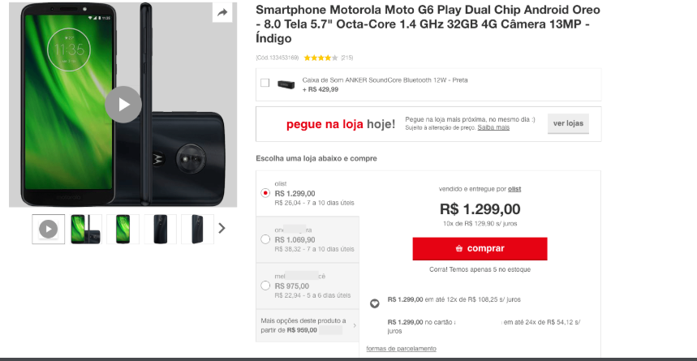
Example of a product listing on a marketplace

Slide 18

Data Schema

Slide 19
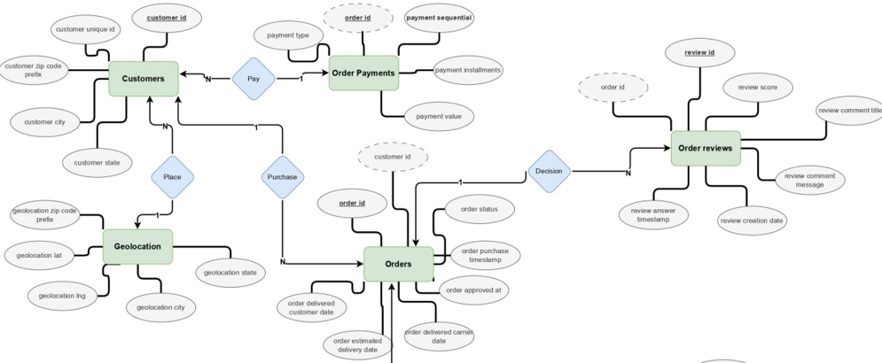
ERD Model

Slide 20
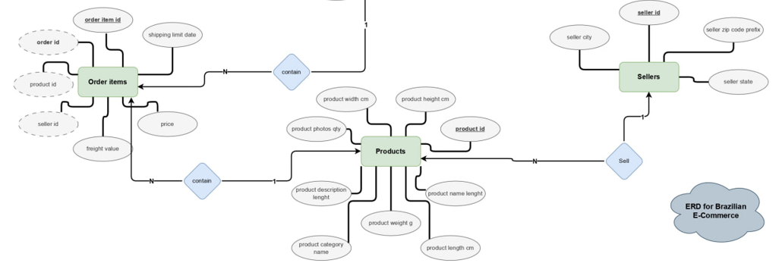

Slide 21
Relationships Between Data Points
From Table | To Table | Key Field(s) | Relationship Type | Meaning
Customers | Orders | customer_id | One-to-Many (1:N) | One customer can place many orders
Orders | Order Payments | order_id | One-to-Many (1:N) | One order can have multiple payment records
Orders | Order Items | order_id | One-to-Many (1:N) | One order can contain multiple items
Orders | Order Reviews | order_id | One-to-One (1:1) | Each order has one review (if completed)
Order Items | Products | product_id | Many-to-One (N:1) | Each item refers to one product
Order Items | Sellers | seller_id | Many-to-One (N:1) | Each item is sold by one seller
Sellers | Geolocation | seller_zip_code_prefix | Many-to-One (N:1) | Seller location is mapped via geolocation
Customers | Geolocation | customer_zip_code_prefix | Many-to-One (N:1) | Customer location is mapped via geolocation
Geolocation | Order customer & Seller | zip_code_prefix | Many-to-Many (N:N) | Used to map cities/states by zip prefix

Slide 22
Languages &
Frameworks

Slide 23







Programming Languages & Frameworks

Slide 24
Project Pipeline

Slide 25
Project Pipeline
Data Collecting
Data Cleaning
EDA
Insights
Data Visualization
KPIs

Slide 26
1- Data Collecting

Slide 27
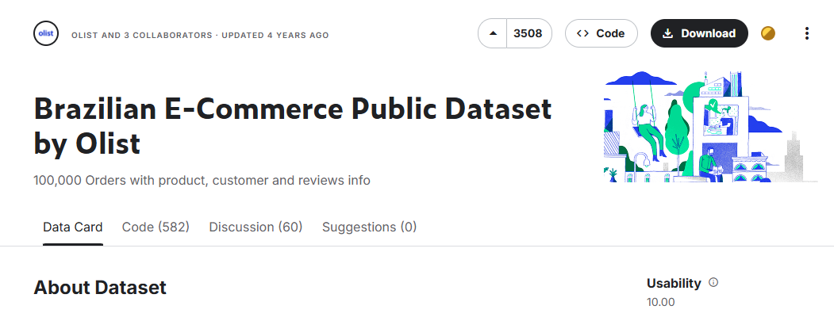
1- Data Collecting
Download the Data files

Slide 28
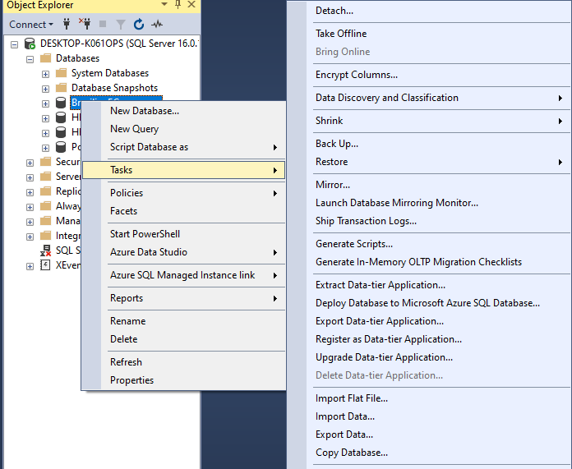
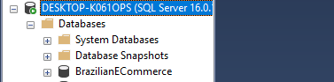
1- Data Collecting
1- Importing And Displaying Dataset In MSQL

Slide 29
1- Data Collecting
2- Importing And Displaying Dataset In Python

Slide 30
2- Data Cleaning

Slide 31
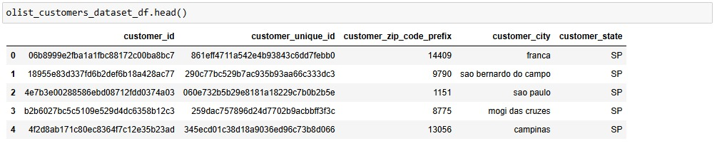
2- Data Cleaning
Displaying Dataset

Slide 32
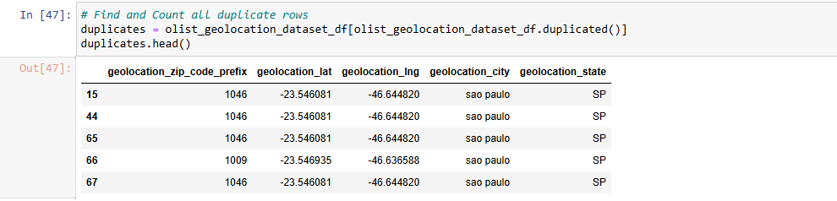
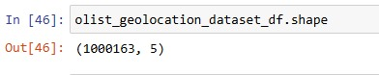
2- Data Cleaning
Duplicates

Slide 33
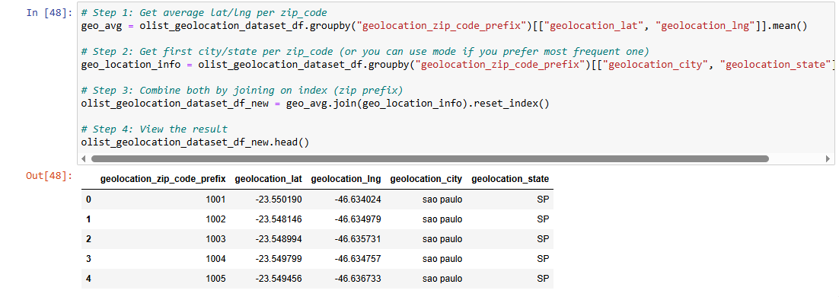
2- Data Cleaning
Dealing with duplicates

Slide 34
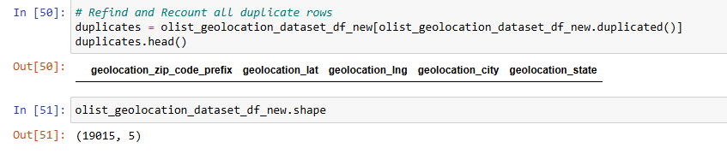
2- Data Cleaning

Slide 35
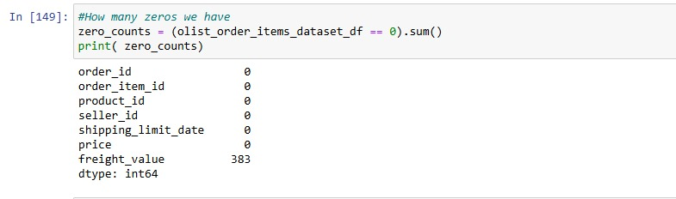
2- Data Cleaning
Dealing with Zeros values (Freight values)

Slide 36

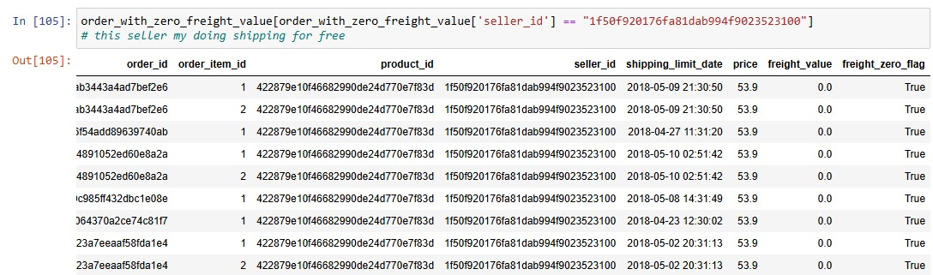
2- Data Cleaning
What is the causes that making the Freight values with Zero values?

Slide 37
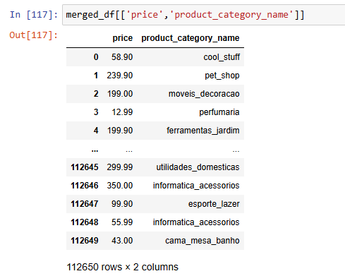
2- Data Cleaning
Dealing with Outliers

Slide 38
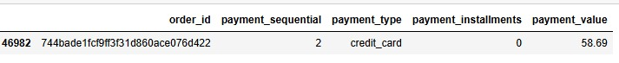
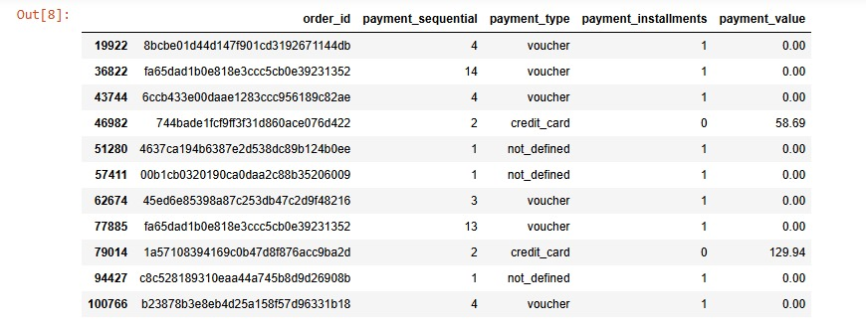
2- Data Cleaning

Slide 39

2- Data Cleaning
Discount or Promotional Voucher (Cupom de Desconto)
Used in e-commerce and retail
Similar to a discount code
Example: You enter a code at checkout to get R$50 off
When You Can Get Up to 100% Off:
1. Promotional Campaigns.
2. Referral or Welcome Bonuses.
3. Refund or Store Credit.

Slide 40
2- Data Cleaning

Slide 41
3- EDA

Slide 42
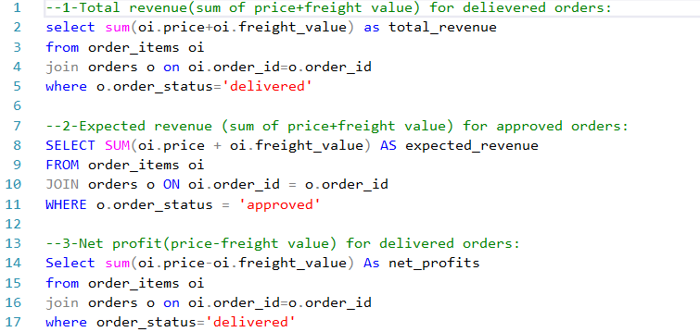
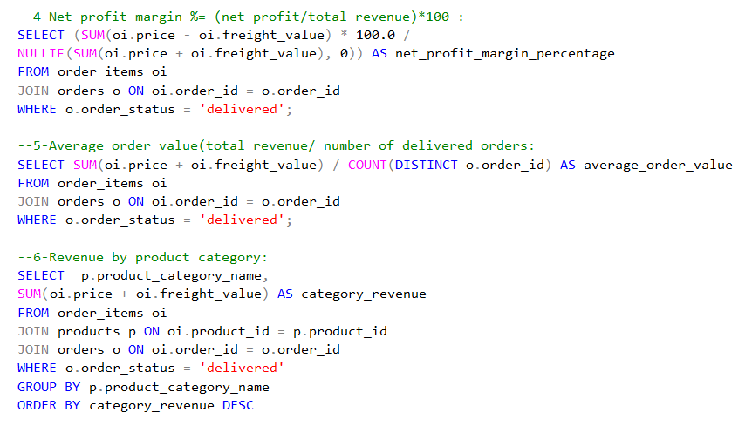
3- Data Exploratory Analysis (SQL)
General EDA

Slide 43
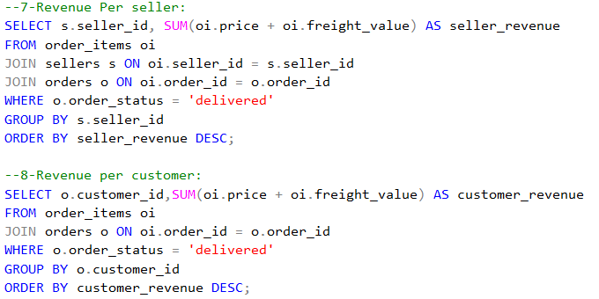
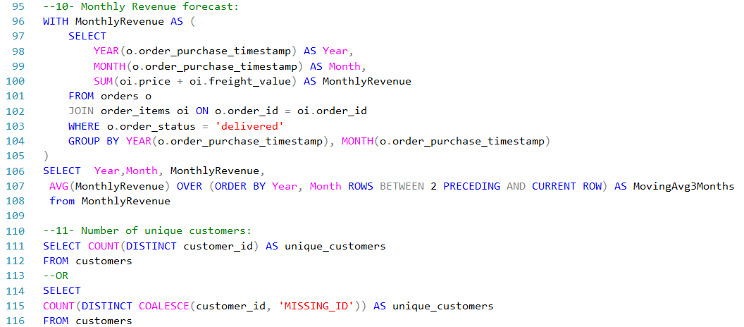
General EDA

Slide 44
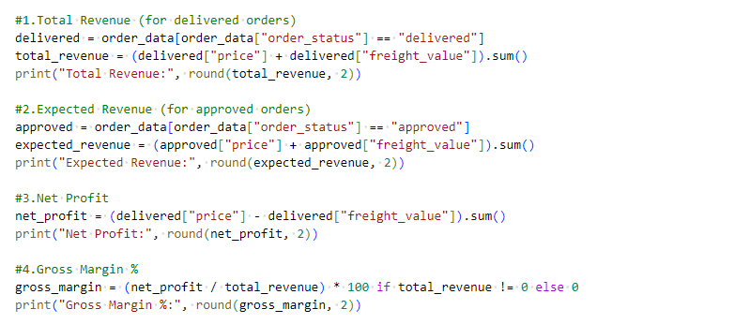
3- Data Exploratory Analysis (Python)
General EDA

Slide 45
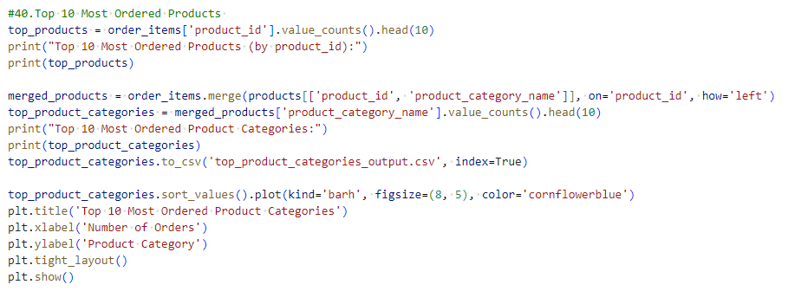
3- Data Exploratory Analysis (Python)
General EDA

Slide 46
4- KPIs

Slide 47
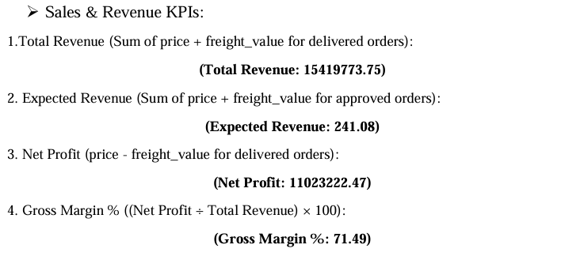
4- KPIs

Slide 48
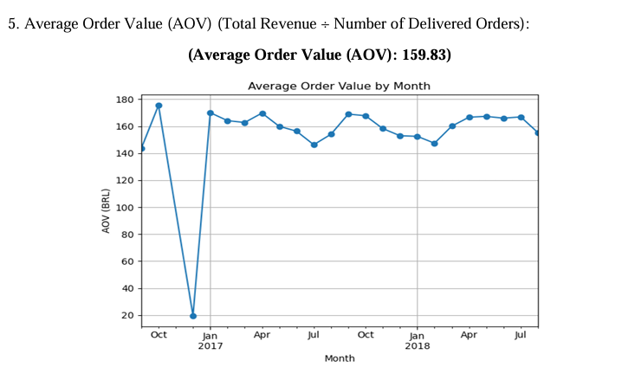
4- KPIs

Slide 49
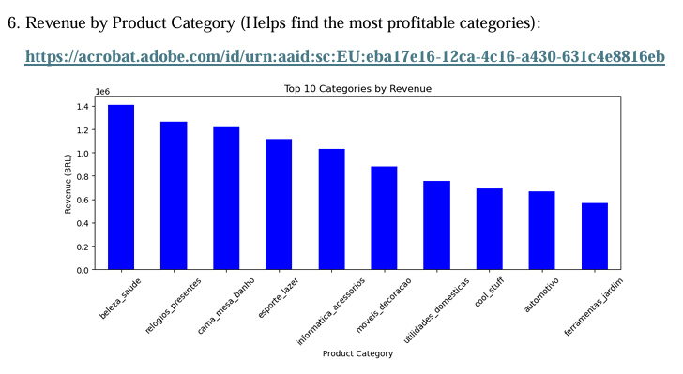
4- KPIs

Slide 50
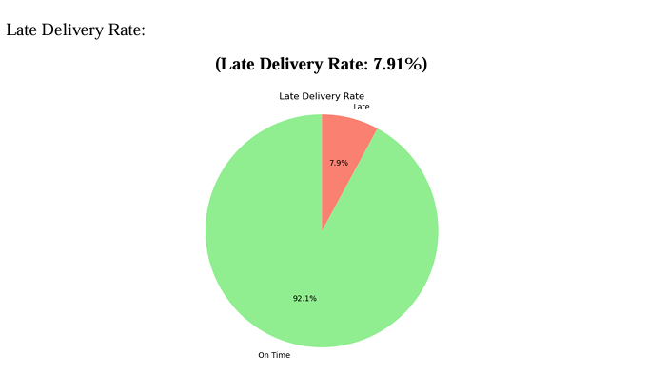
4- KPIs

Slide 51
5- Visualization

Slide 52
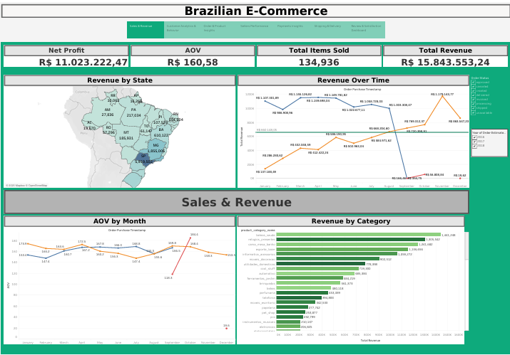
5- Data visualization (Tableau)

Slide 53
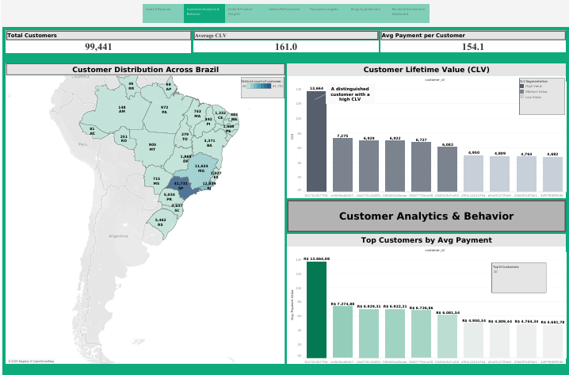
5- Data visualization (Tableau)

Slide 54
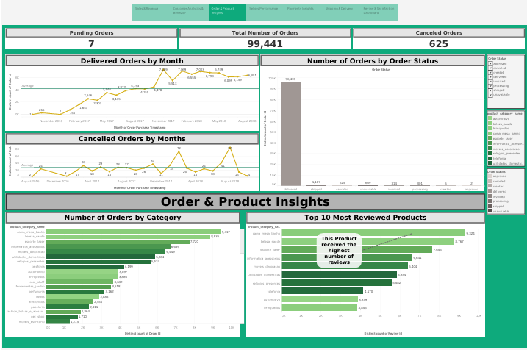
5- Data visualization (Tableau)

Slide 55
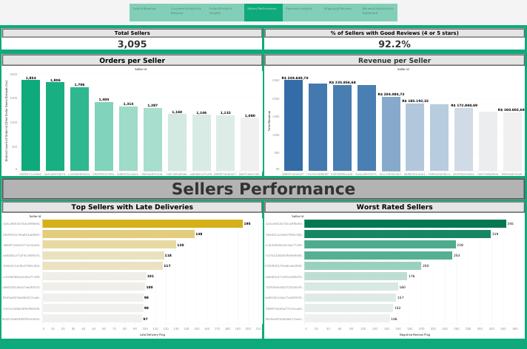
5- Data visualization (Tableau)

Slide 56
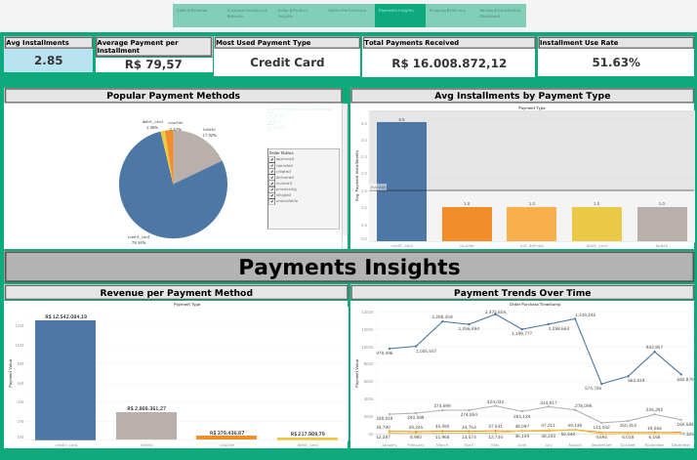
5- Data visualization (Tableau)

Slide 57
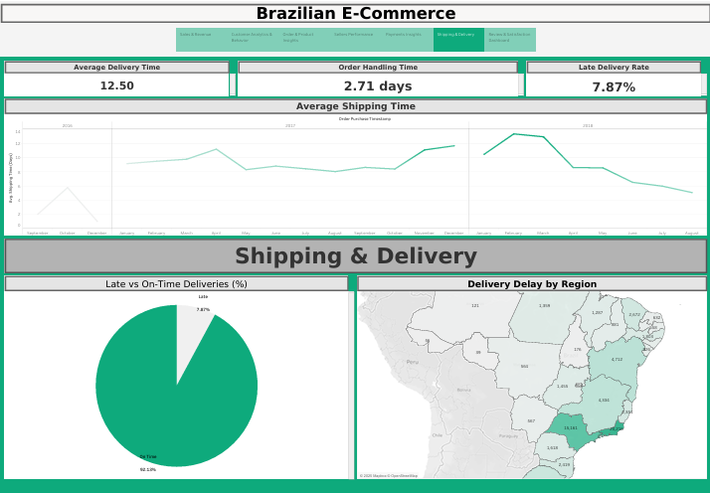
5- Data visualization (Tableau)

Slide 58
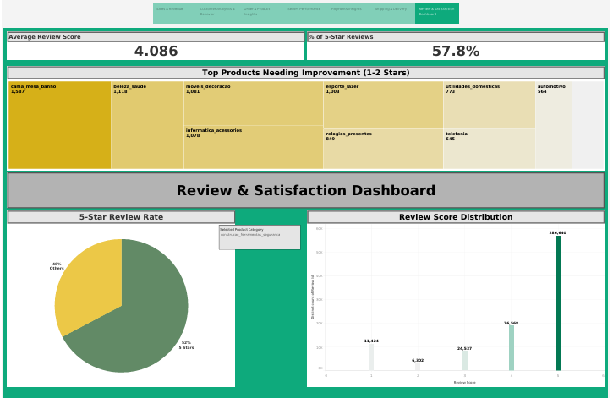
5- Data visualization (Tableau)

Slide 59
6- Business Insights

Slide 60
6- Business Insights
1. Customer Retention & Loyalty
KPI Insight:
Returning Customers = 0
Customer Lifetime Value not leveraged
Suggested Actions:
Launch a loyalty program to reward repeat purchases
Use email marketing to re-engage past customers
Offer personalized recommendations or discounts for 2nd purchase
Set up remarketing ads for one-time buyers

Slide 61
6- Business Insights
2-Shipping & Delivery Optimization
KPI Insight:
Average Delivery Time = 12.09 days
Late Delivery Rate = 7.91%
Delay (Late Orders) = 8.74 days
Suggested Actions:
Evaluate and switch slow logistics partners
Use regional warehouses for faster delivery
Show estimated delivery dates clearly to manage expectations
Reward sellers with fast fulfillment (via visibility or bonuses)

Slide 62
6- Business Insights
3-Product Quality & Review Management
KPI Insight:
Avg. Review Score = 4.09
5-star Reviews = 57.78%
18,711 orders at risk of return (low ratings)
Suggested Actions:
Identify and remove or improve low-rated products
Work with sellers to enhance product descriptions and images
Send post-delivery follow-up emails to encourage positive reviews
Introduce seller quality scoring system

Slide 63
6- Business Insights
4. Increase Revenue per Customer
KPI Insight:
AOV = R$159.83
CLV not fully optimized
Suggested Actions:
Offer bundles or “Buy more, save more” discounts
Implement cross-sell in cart and checkout

Slide 64
6- Business Insights
5. Payment Behavior & Incentives
KPI Insight:
Credit card = 73.92%
Voucher usage = 5.56%
Installments used in 49.42% of orders
Suggested Actions:
Offer interest-free installment plans for higher AOV
Increase voucher-based promotions for new users
Provide more flexible payment methods (Pix, digital wallets)

Slide 65
6- Business Insights
6. Seller Management
KPI Insight:
3,095 sellers, performance varies
Revenue per seller and reviews differ
Suggested Actions:
Highlight top-performing sellers on homepage
Offer training or support to low performers
Create a seller scorecard (based on revenue, reviews, shipping speed)

Slide 66
6- Business Insights
7. Regional Expansion
KPI Insight:
Revenue & orders vary by state and city
Suggested Actions:
Focus marketing efforts in top-performing regions
Launch localized campaigns or discounts
Improve shipping options in underserved areas

Slide 67
Deliverables

Slide 68
Deliverables
Cleaned Dataset files (CSV)
A comprehensive description that effectively communicates the details of our project (Power Point).
A ZIP File containing our Project Source Code. (python, sql, tableau)
A URL to our Live application, system, or dashboard after deployment. (Tableau public)
Project Documentation (project design, wireframe, model, visualizations.)

Slide 69
Milestones

Slide 70
TimeTable
Week 1 (March 14 - March 20, 2025) o Data Collection & Understanding o Explore dataset structure and identify missing values o Define key metrics for analysis 2.
Week 2 (March 21 - March 27, 2025) o Data Cleaning & Preprocessing o Handle missing and inconsistent data o Ensure data is well-structured for analysis 3.
Week 3 (March 28 - April 3, 2025) o Exploratory Data Analysis (EDA) & Visualization Generate statistical summaries and visual insights o Identify trends in customer behavior and product performance
St
Week 4 (April 4 - April 10, 2025) o Advanced Analysis & Modeling o Perform sentiment analysis on customer reviews o Analyze operational efficiency and forecast trends
Final Week (April 11 - April 14, 2025) o Dashboard & Report Preparation o Create final visualizations and insights using Tableau Prepare project presentation and documentation
3
1
END
2

Slide 71
Resources

Slide 72
Resources
Full Project & source code on GitHub
Dashboard On tableau public
Dataset on Kaggle

Slide 73
Thanks

